Slide 1
Public Participation
Key Stage 3

Slide 2



Check your knowledge…
Why does Public participation matter?
How can Public participate?

Slide 3
DEMOCRACY; a government in which the supreme power is vested in the people and exercised by them directly or indirectly through a system of representation usually involving periodically held free elections
DEMOCRACY
meaning comes from 2 words of ancient Greek
‘Demos’
‘Kratos’
Meaning
“The people”
Meaning “rule”
(Merriam-Webster Dictionary)

Slide 4

Why is Public Participation important?
Allows Citizens to have a say in the legislative process
Hold elected representatives accountable
Contribute to the decision-making that affects their lives

Slide 5

Can Public actually participate in work of Majlis?
Article 88 (a)2 of the Maldivian Constitution
“Subject to the provisions of this Constitution, the People’s Majlis shall: make regulations and principles concerning its business, with due regard to representative and participatory democracy, accountability, transparency and public involvement”

Slide 6
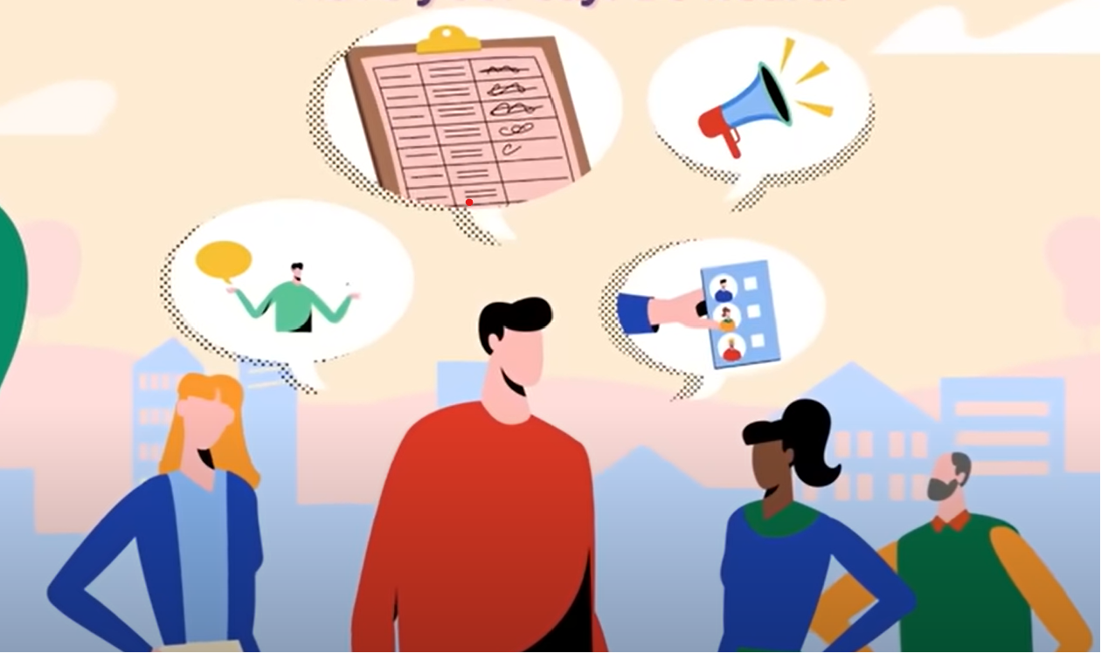
What are the ways Public can participate in work of Majlis?

Slide 7






Several ways to get involved…
Voting
Submit letters
Contacting MPs
Attend Parliamentary Sittings and Committee meetings
Petitions
Online Platforms
Notes:
Visiting the Parliament: Citizens can visit the parliament and observe preliminary sittings or committee meetings. The Parliament Office offers guided tours and educational programs for schools and the general public.

Slide 8

Majlis website provides…
MPs official email address and links to social media handles.
Minutes of preliminary sittings and committee meetings
Agenda of preliminary sittings
Bills/motions/resolutions that are under consideration at the Majlis floor (unless confidential)
Committee Reports
Live streamed video of preliminary sittings and live stream of audio is for committee meetings
Public announcements (such as invitation to submit public comments to Bills) are done via all the Majlis social media handles
www.majlis.gov.mv

Slide 9

Questions?

